Slide 1
6305 Lecture
YanYan Zhou

Slide 2
Entering Data Into SAS
data first;
    the name of the data set
input x @@;
    tells SAS to remain on the current line for more data (otherwise, SAS looks to the next line for the next data point)
cards;
    sometimes datalines is used instead;
17.2 4.7 15.9 4.1
11.0 7.9 5.1 -3.7
run;
    Indicates end of datalines

Slide 3
Print
proc print data=first;
    /* tells SAS to use the data set named ‘first’*/
run;
  /* indicates the end of the procedure */
quit;
    /* at the end of a program, it is best, though not necessary, to use this command */

Slide 4
Summary Statistics
proc univariate data=first;
    /* procedure which gives means, /* medians, percentiles, etc.*/
var x;
    /* tells SAS to use only the variable x*/
run;
quit;

Slide 5
ANOVA for CRD
proc glm data=balance;
    /* the general linear models procedure*/
class treatment;
    /* tells which variable denotes the different populations or groups */
model y=treatment;
    /* tells SAS that the outcome and population variables are in this line */
    outcome variable is on the left-hand side of the equation and the explanatory variable is on the right-hand side.
run;
quit;

Slide 6
ANOVA for factorial
Class A B;
  model y=A B AB;
Additive Model
  model y=A B AB;

Slide 7
Checking assumptions - Normality
proc glm data=balance;
class A;
model y=A;
output out=resids r=res;
    /* instructs SAS to create a new data set called ‘resids’ and put the residuals from the model into that data set and call them ‘res’
    view what else is in that data set by using proc print immediately
run;
proc univariate normal plot;
    /* Tells SAS to run tests of normality and give a QQ-plot */
var res;
run;

Slide 8
Checking Assumption – Constant Variance
proc glm data=balance;
class A;
model logy=A;
means A / hovtest=levene;
  /* Performs the Levene test for the factor A */
output out=resids r=res;
run;
proc univariate normal plot;
var res;
run;

Slide 9
Levene test
The hovtest=levene option above only works in one-way ANOVA models
The Levene test is defined as:
  H0: σ₁ = σ₂ = ... = σ_{k}
  Ha: σ_{i} ≠ σ_{j} for at least one pair (i,j).

Slide 10
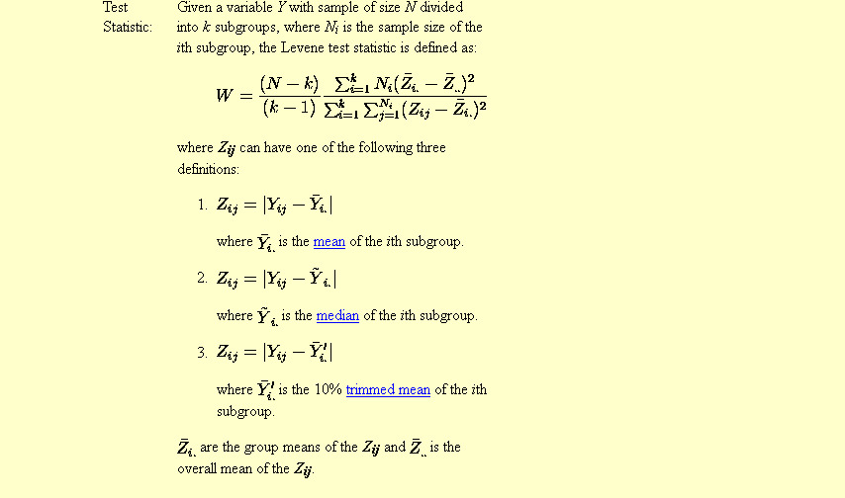

Slide 11
Construct a Levene Test
proc glm data=balance;
class A;
model logy=A;
output out=resids r=res;
run;
data levene;
set resids;
res2=res*res;
    /* res2=res**2 has the same effect*/
run;
proc glm;
class A;
model res2=A;
run;

Slide 12
Multiple comparison
proc anova data=Clover;
class Strain;
model Nitrogen = Strain;
means Strain / tukey;
means Strain/ lsd tukey cldiff ;
    The CLDIFF option requests confidence intervals for both tests.
run;

